Slide 1
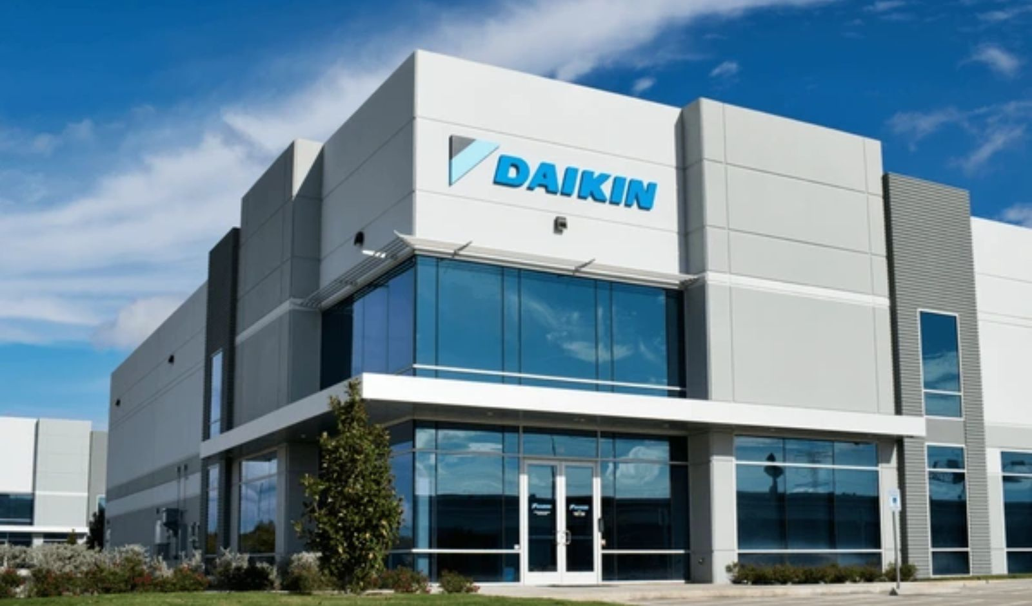
Daikin & DJIME Collaboration: Optimizing HVAC with Data Analytics
This presentation highlights the joint project between Daikin Industries and DJIME (Daikin Joint Innovation and Management Engineering Center), aimed at utilizing data analytics to enhance HVAC system performance. It will explore the project's objectives, methodologies, key insights, and practical recommendations. This collaboration reflects Daikin's dedication to innovation and data-driven decision-making.
Submitted by :
Navneet Mittal
055026
BDA -05
Section K
Notes:
1

Slide 2
Problem Statement & Objectives: Enhancing Efficiency & Reliability
Problem Statement
Project Objectives
The project focuses on two key challenges: excessive energy consumption in Daikin's HVAC systems, which drives up operational costs and environmental impact, and the absence of effective predictive maintenance, leading to unplanned downtime and expensive repairs. Energy usage is estimated to be 15% higher than the industry average, while unplanned downtime incurs an annual cost of approximately $50,000.
Reduce energy consumption by 10% within 6 months.
Predict HVAC system failures with 90% accuracy.
Decrease unplanned downtime by 20% by Q4 2024.
Notes:
2

Slide 3

Data Analysis Methodology: A Multi-Faceted Approach
Data Sources
Data Preprocessing
The analysis utilized a variety of data sources, including HVAC system sensor data (temperature, pressure, flow rate), maintenance records spanning 10 years, energy consumption bills, weather data, and production data, totaling 500 GB of sensor readings.
Data preprocessing steps involved handling missing values through imputation, outlier detection using statistical methods, and data normalization/standardization to ensure consistent scaling across variables.
Analytical Techniques
Analytical techniques employed regression analysis, time series analysis, clustering, and machine learning algorithms such as Random Forest, SVM, and XGBoost. Specific algorithms included XGBoost for predictive maintenance and K-Means clustering for anomaly detection using Python (Scikit-learn, Pandas), and visualized through Tableau.
Notes:
3

Slide 4
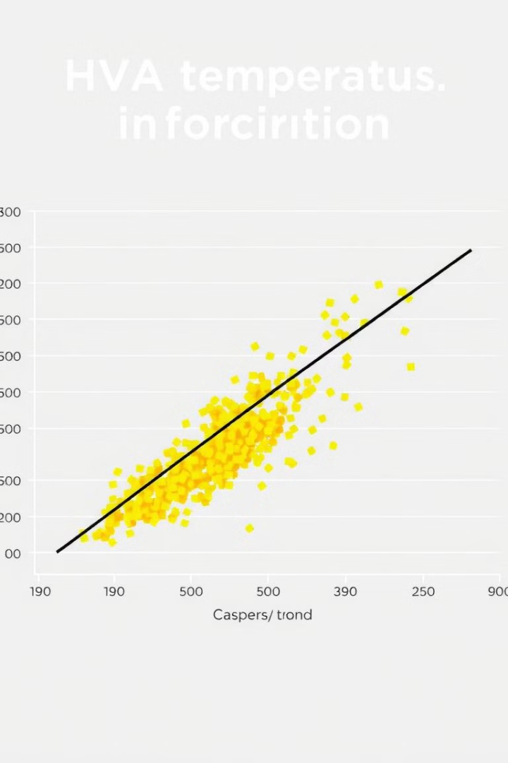



Observations & Key Findings: Unveiling Hidden Patterns
Observation 1
A strong correlation was found between ambient temperature and HVAC energy consumption, with a correlation coefficient of 0.85 between temperature and energy use.
Observation 2
Certain HVAC components showed a pattern of failure after a specific operational threshold. 70% of compressors failed after 5000 hours of operation.
Observation 3
Significant energy waste during off-peak hours was observed due to inefficient system scheduling. Energy consumption during off-peak hours was 40% higher than predicted.
Notes:
4

Slide 5

Insights & Results: Transforming Data into Action
1
Insight 1
2
Insight 2
Predictive models can be built to optimize HVAC settings based on weather forecasts, leading to potential energy savings of 8% based on model simulations.
A predictive maintenance schedule can be implemented to replace components before failure, reducing downtime by a predicted 15% based on simulation results.
3
Insight 3
Adjusting HVAC schedules based on occupancy patterns and real-time demand can significantly reduce energy waste, with an estimated energy savings of 12% during off-peak hours by optimizing schedules.
Notes:
5

Slide 6
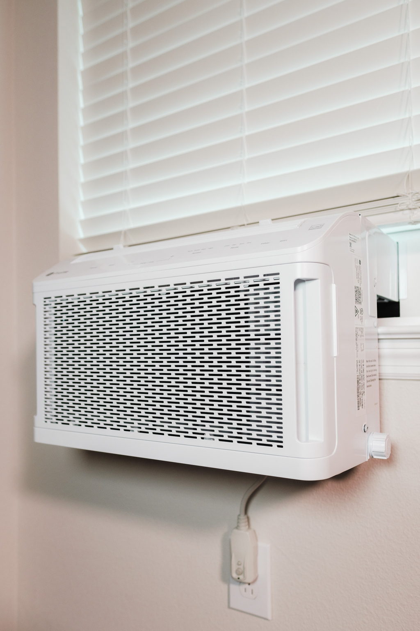
Project Status & Next Steps: Moving Forward
1
Project Status
The project is currently ongoing. Milestones achieved include development of predictive models and identification of key factors influencing energy consumption. Challenges faced include data integration and model validation.
2
KPIs
Key Performance Indicators: Energy consumption reduced by 7% (Target: 10%), predictive accuracy at 85% (Target: 90%), and downtime reduced by 10% (Target: 20%).
3
Next Steps
Planned activities include deployment of the predictive maintenance system, implementation of optimized HVAC schedules, further refinement of predictive models, and exploring integration with other Daikin systems. Further research is planned to investigate the impact of air quality on HVAC performance and develop more sophisticated predictive models using deep learning.
Notes:
6

Slide 7
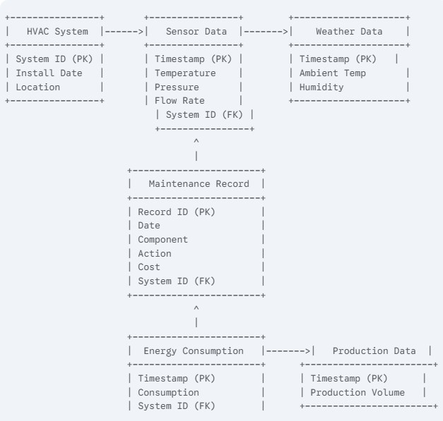
ERD Diagram

